Slide 1

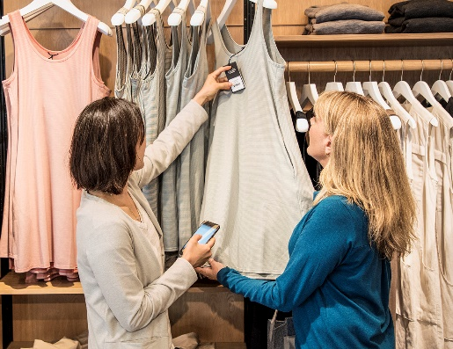
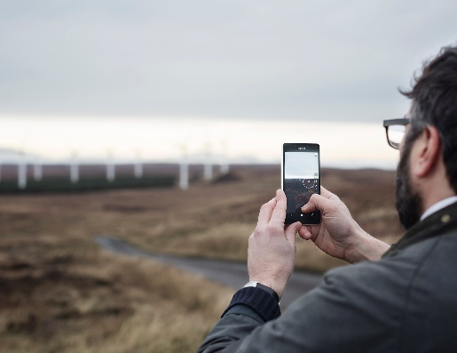




Build end-to-end IoT solutions Work with Azure IoT Edge
Pamela Cortez
Azure IoT

Slide 2

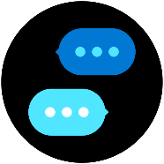



Build end-to-end IoT solutions – Workshop Series
https://aka.ms/IoT-online-workshop
Transform your business with IoT
Devices and device communication
Device provisioning at scale
Messaging processing, analytics, and business integration
Work with Azure IoT Edge
Notes:
In our first session, we’ll cover how Azure IoT is being adopted by enterprises and the problems that can be solved when you enable real-time digital feedback loops through the cloud. In the first labs, you’ll get started with the Azure portal, creating a dashboard and resource group. You’ll then explore the Azure services that will be used to provision and connect devices (IoT Hub and IoT Hub Device Provisioning Service)
Devices and device communication
In this session, we’ll take you through preparing a development environment you can use to build your IoT solution, both on the Azure cloud side and for your local work environment. For the labs, we’ll walk through evaluating a monitoring solution prior to full-scale implementation; you’ll connect a simulated IoT device that includes temperature and humidity sensors to IoT Hub; and you’ll verify that device telemetry is being received.
Device provisioning at scale
This portion of the workshop scenario walks through a hypothetical asset-monitoring solution that requires an IoT device with sensors for tracking location, temperature, and pressure included in product transport boxes. You’ll learn how you can use Azure Device Provisioning Service to enroll many devices automatically and securely.
Messaging processing, analytics, and business integration
You’ll write code to send continuous telemetry to an IoT Hub that will use Azure Stream Analytics and a built-in machine learning model to warn of anomalies. Power BI will be used to visualize the data stream, and you’ll create an event subscription within Azure IoT Hub to set up Event Grid integration that will trigger a logic app to send an alert.
Work with Azure IoT Edge
With large amounts of data being collected and urgent time responses needed, you’ll want to bring the intelligence to the edge for processing data and only send the important data to the cloud. Working through the exercises, you will setup an IoT Edge gateway; develop, deploy, and debug a custom module on Azure IoT Edge; and then run an IoT Edge device offline and in a restricted network.

Slide 3
Work with Azure IoT Edge
IoT Edge Overview & Features
AI on the Edge Overview
Tooling Support for IoT Edge
Lab:
Set up and deploy an IoT Edge Device
Developer Modules
Configure an IoT Edge device
Developer Resources & Getting started

Slide 4








Innovations enabling new opportunities
Digital Twins
AI
Cloud
IoT
Edge
Globally available, unlimited compute resources
Harnessing signals from sensors and devices, managed centrally by the cloud
Intelligence offloaded from the cloud to IoT devices
Breakthrough intelligence capabilities, in the cloud and on the edge
Create living replicas of any physical environment, track the past and predict the future

Slide 5
IoT in the Cloud and on the Edge
How can we make these slides feel like they are from the same family?
IoT in the Cloud
Remote monitoring and management
Merging remote data from multiple IoT devices
Infinite compute and storage to train machine learning and other advanced AI tools
IoT on the Edge
Offline operations (short and long term)
Privacy of data and protection of IP
Pre-process data on prem – E.g. video streams
Low latency tight control loops require near real-time response
Protocol translation & data normalization
Consistency

Slide 6
Challenges today create high barriers to entry
Cloud barriers
Edge barriers
High volume of data collection sources
High developer skillset for hardware, cloud, edge
High cost of transporting data to the cloud
custom code for everything = No standardization
Limits to real-time insights
Manual set up and integration = Does not scale

Slide 7
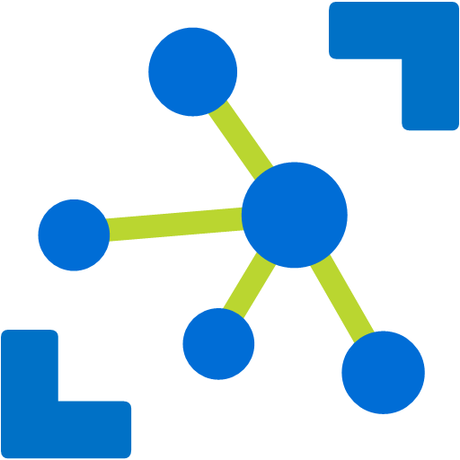


IoT application pattern + edge intelligence
Microsoft Azure
Things
Azure IoT Hub
Cloud Gateway
Insights
Actions
Insights
Actions

Slide 8

Edge intelligence enabled with Azure IoT Edge
Container Registry
Azure
IoT Hub
Custom
Code
(data transform)
Azure Cognitive Services
(insight)
Custom Code
(action)
Video Camera
Workload description
Container
Container
Container
IoT Edge runtime
Device deployment
& management

Slide 9


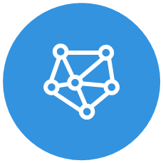

Azure IoT Edge features
Open
Secure
Intelligent
Enterprise ready
Open source
Moby-based container runtime, compatible with Docker containers
Azure IoT Edge Marketplace for Edge modules
Zero-touch provisioning of Edge devices at scale with Device Provisioning Service
Security framework provides end to end security and support for variety of hardware-based root of trust
Trusted computing via Open Enclave
Services onboarded
Azure Machine Learning
Azure Stream Analytics
Custom Vision & more
Blob storage
Nvidia Deepstream
RedisEdge
SQL Server on Edge
Alleantia Industrial GW
Aveva IoT Edge HMI
Codit Nebulus
Swim Enterprise
… and more in the marketplace
Scaled deployments with Automatic Device Configuration Service
Use existing coding skills (C, C#, Node, Python, Java)
Development tooling in Visual Studio and VSCode
Multi-person development tools for CI/CD using VSTS
IoT Central integration - PP

Slide 10


Microsoft IoT
Broadest portfolio
Industry Solutions
Manufacturing
Retail
Agriculture
Energy
Smart Cities
Healthcare
Transportation
Azure IoT Central
Dynamics Connected Field Service
IoT app services
Azure IoT Hub
Azure IoT Hub Device Provisioning Service
Azure Digital Twins
Azure Time Series Insights
Azure Maps
Azure Security Center for IoT
Azure Stream Analytics
Azure Cosmos DB
Azure AI
Azure Cognitive Services
Azure ML
Azure Logic Apps
Azure Active Directory
Azure Monitor
Azure DevOps
Power BI
Azure Data Share
Azure Spatial Anchors
Azure services for IoT
Azure RTOS
Azure Sphere
Azure IoT Device SDK
Azure IoT Edge
Azure Stack Edge
Windows IoT
Azure Certified for IoT—Device Catalog
Azure Stream Analytics
Azure Storage
Azure ML
Azure SQL
Azure Functions
Azure Cognitive Services
IoT & Edge Device Support

Slide 11
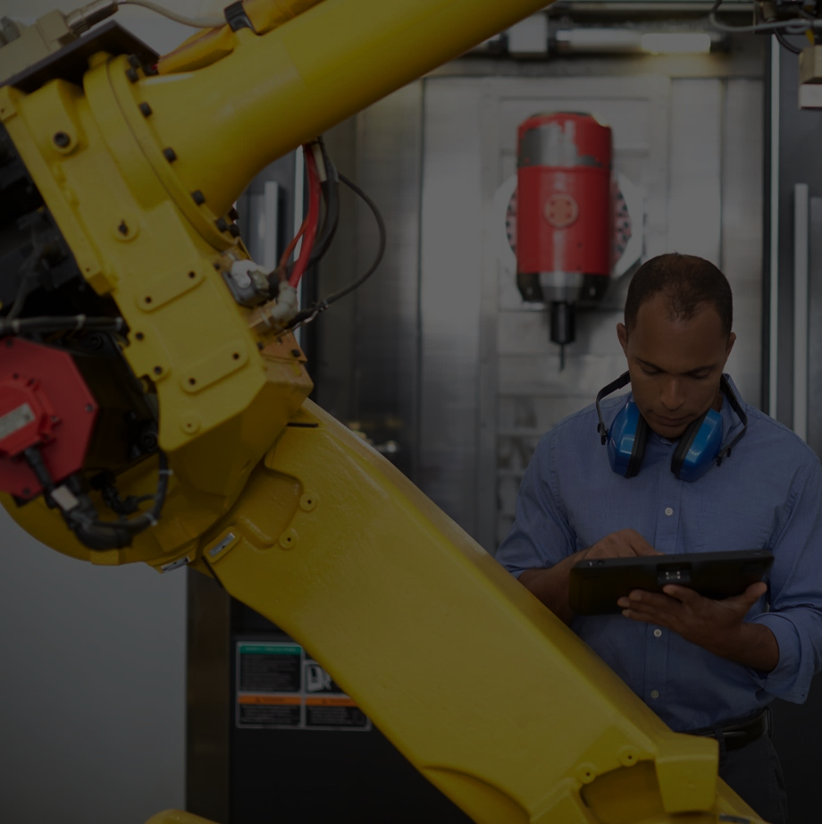
Move cloud and custom workloads to the edge, securely
Seamless deployment of AI and advanced analytics
Azure IoT Edge
Configure, update and monitor from the cloud
Compatible with popular operating systems
Code symmetry between cloud and edge for easy development and testing
Secure solution from chipset to cloud

Slide 12
Bringing Compute Where The Data As
Azure Container Registry
Azure
IoT Hub
Data collection
Machine
Learning
Service
Alert
IoT Edge Device
Deployment Manifest
Container
Container
Container
Sensors
Notes:
\

Slide 13
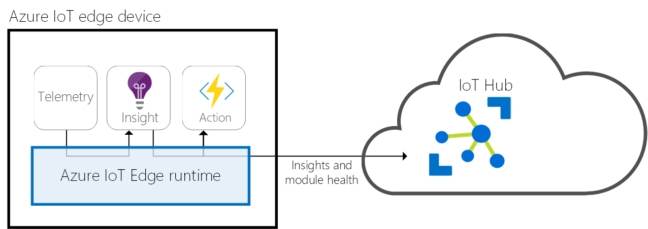
IoT Edge Runtime
Telemetry
Installs and updates workloads on the device.
Maintains Azure IoT Edge security standards on the device.
Ensures that IoT Edge modules are always running.
Reports module health to the cloud for remote monitoring.
Facilitates communication between downstream leaf devices and the IoT Edge device.
Facilitates communication between modules on the IoT Edge device.
Facilitates communication between the IoT Edge device and the cloud

Slide 14
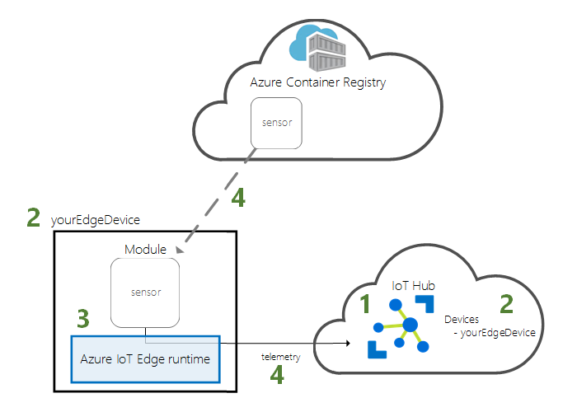
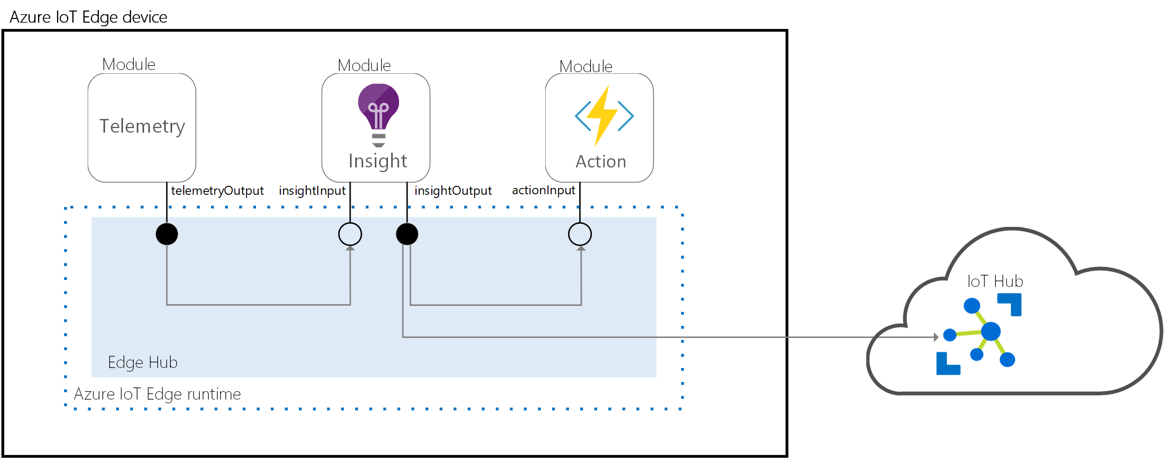
IoT Edge Runtime: System Modules
edge-agent:
Deployment & Container orchestration
Ensures module uptime
edge-hub:
Communication to/from Azure IoT Hub
Inter-module communication

Slide 15
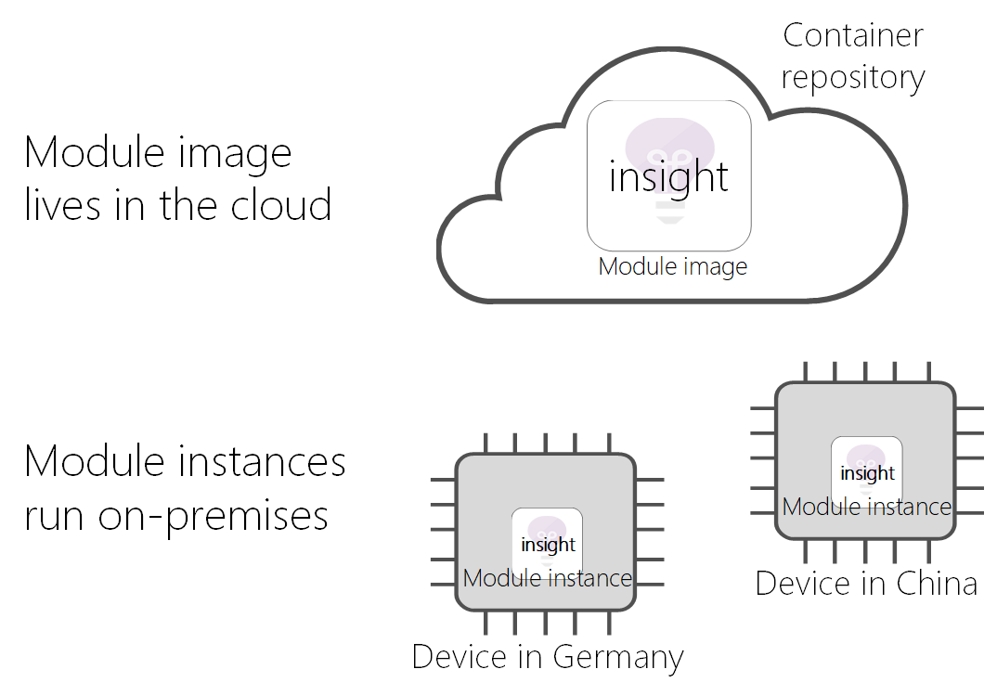
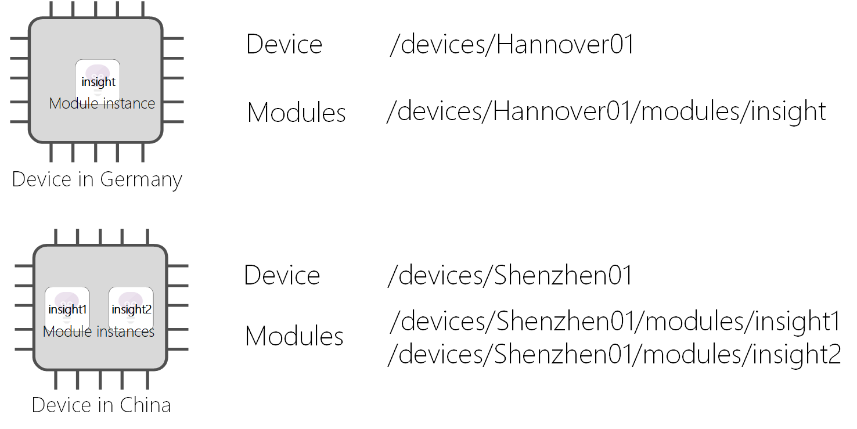
Concept – Module
A module image is a package containing the software that defines a module.
A module instance is the specific unit of computation running the module image on an IoT Edge device. The module instance is started by the IoT Edge runtime.
A module identity is a piece of information (including security credentials) stored in IoT Hub, that is associated to each module instance.
A module twin is a JSON document stored in IoT Hub, that contains state information for a module instance, including metadata, configurations, and conditions.
SDKs to develop custom modules in multiple languages (C#, C, Python, Java, Node.JS)

Slide 16
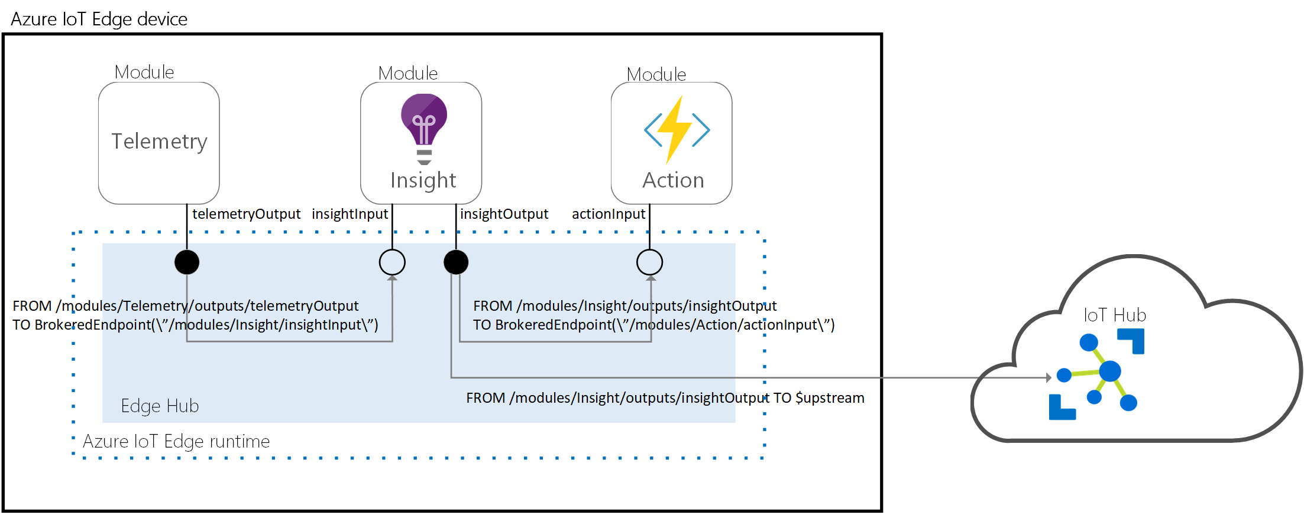
Communication Patterns - Routing
IoT Hub
FROM <source> WHERE <condition> INTO <sink>

Slide 17
Azure IoT Edge security
Security is critical for IoT devices
Azure IoT Edge has an industry leading security framework
Secure boot
Secret storage
Correct workload
Encrypted communication
Secure execution (public preview)
Security monitoring
Module
Module
Module
Security monitor
IoT Edge runtime
Trusted Execution Env
Sensitive code
Secure Boot and Updates
ROM
Hardware security module
Secure Processor

Slide 18
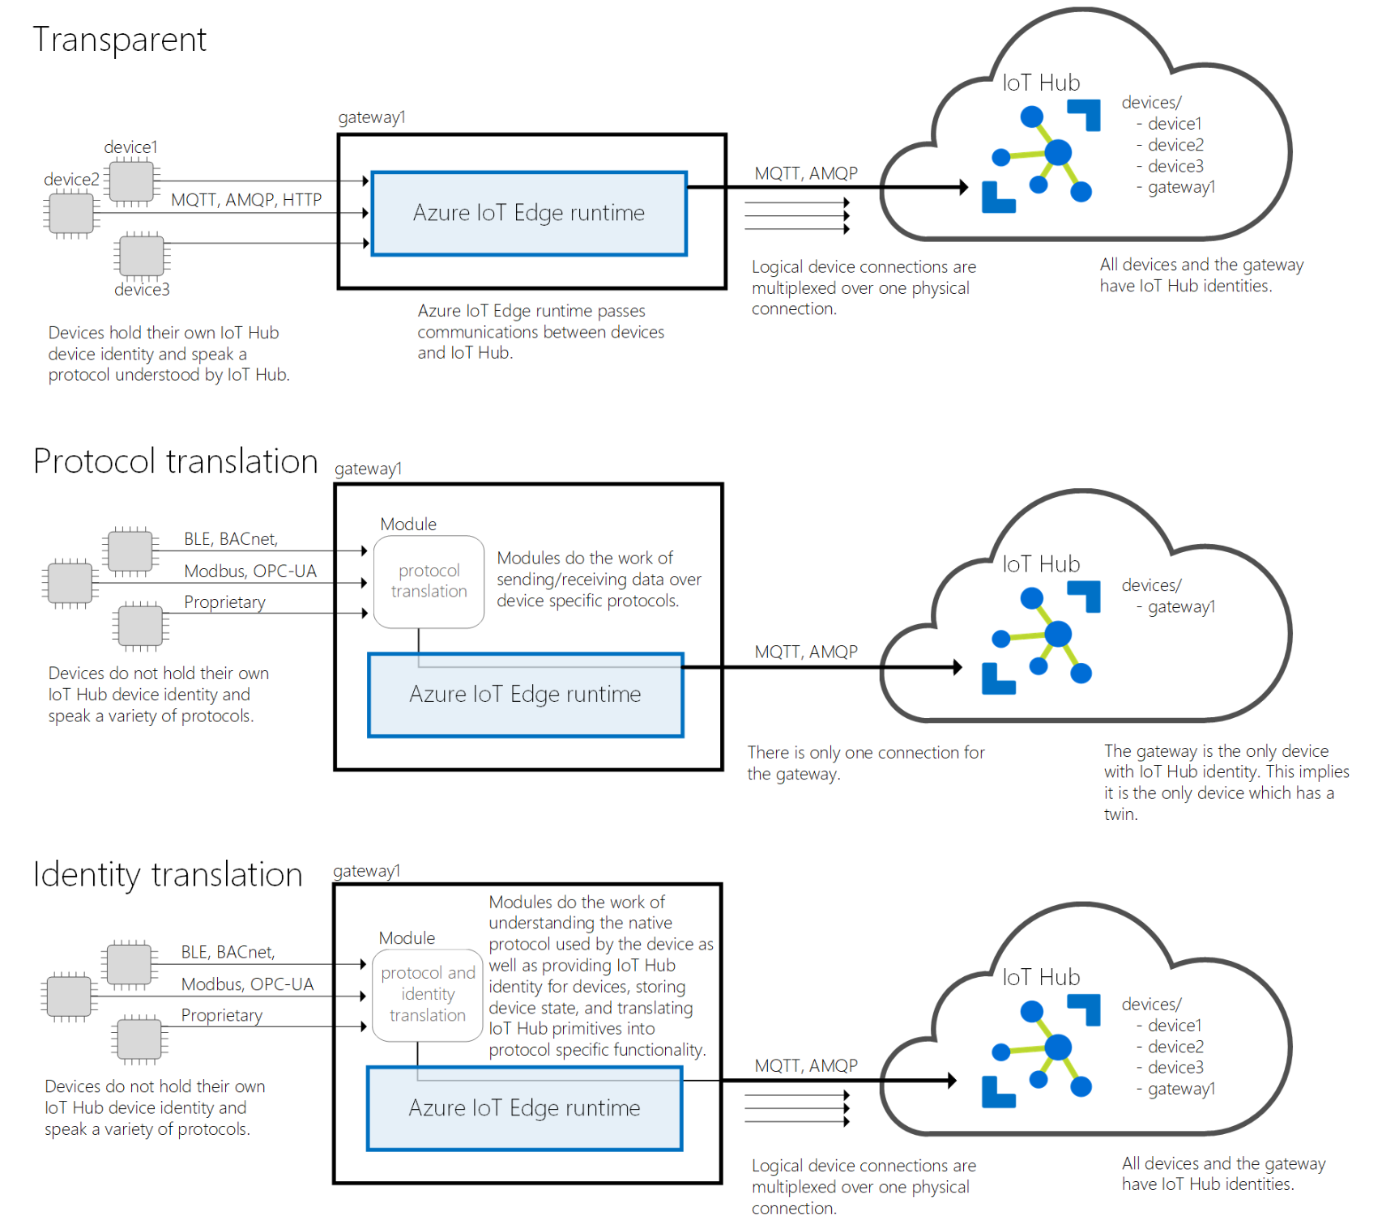
Azure IoT Edge as a Gateway (Patterns)

Slide 19
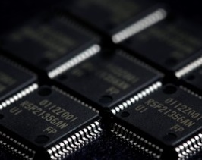
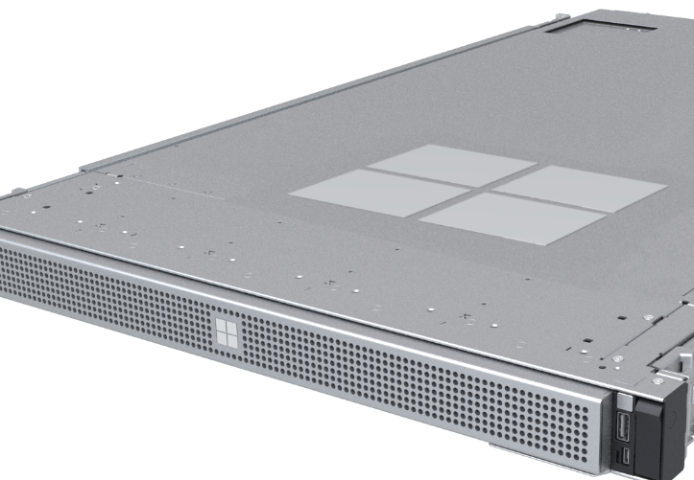
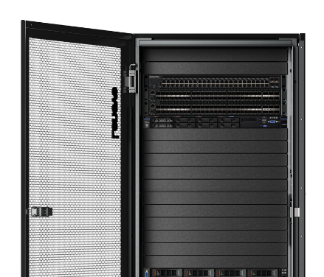
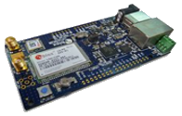
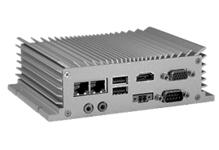
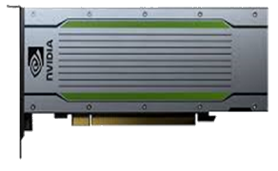
Enabling intelligent edge spectrum
Sensors
Constrained
Industrial
Accelerated
Server
Stack
Azure IoT Edge requirements
Hardware sizing depends on workload
Flexible architecture – ARM or AMD64
Linux and Windows
Moby-compatible container runtime

Slide 20
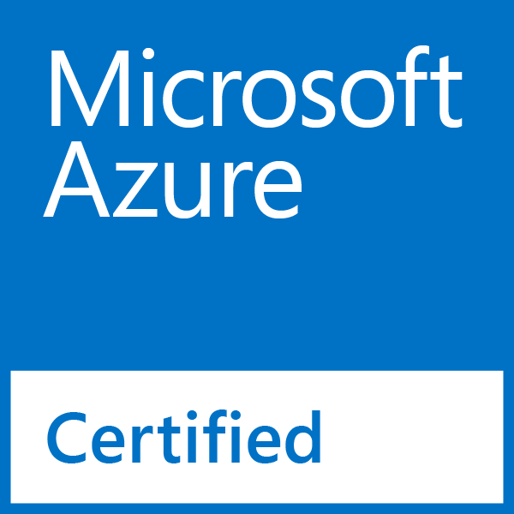
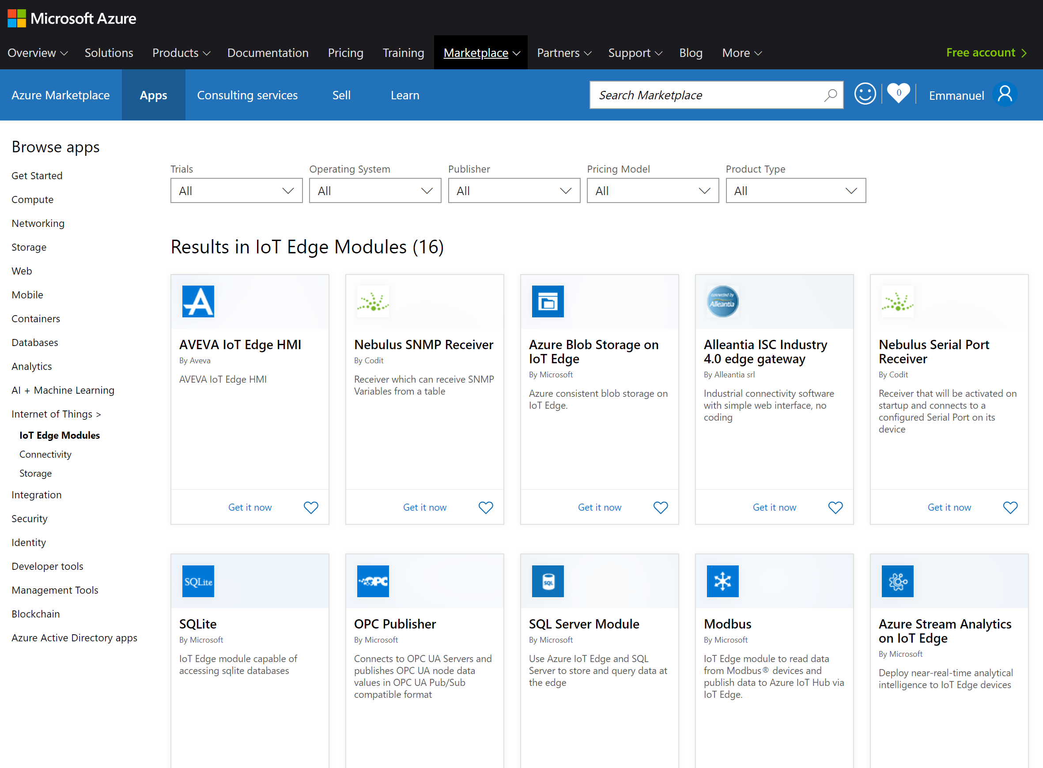
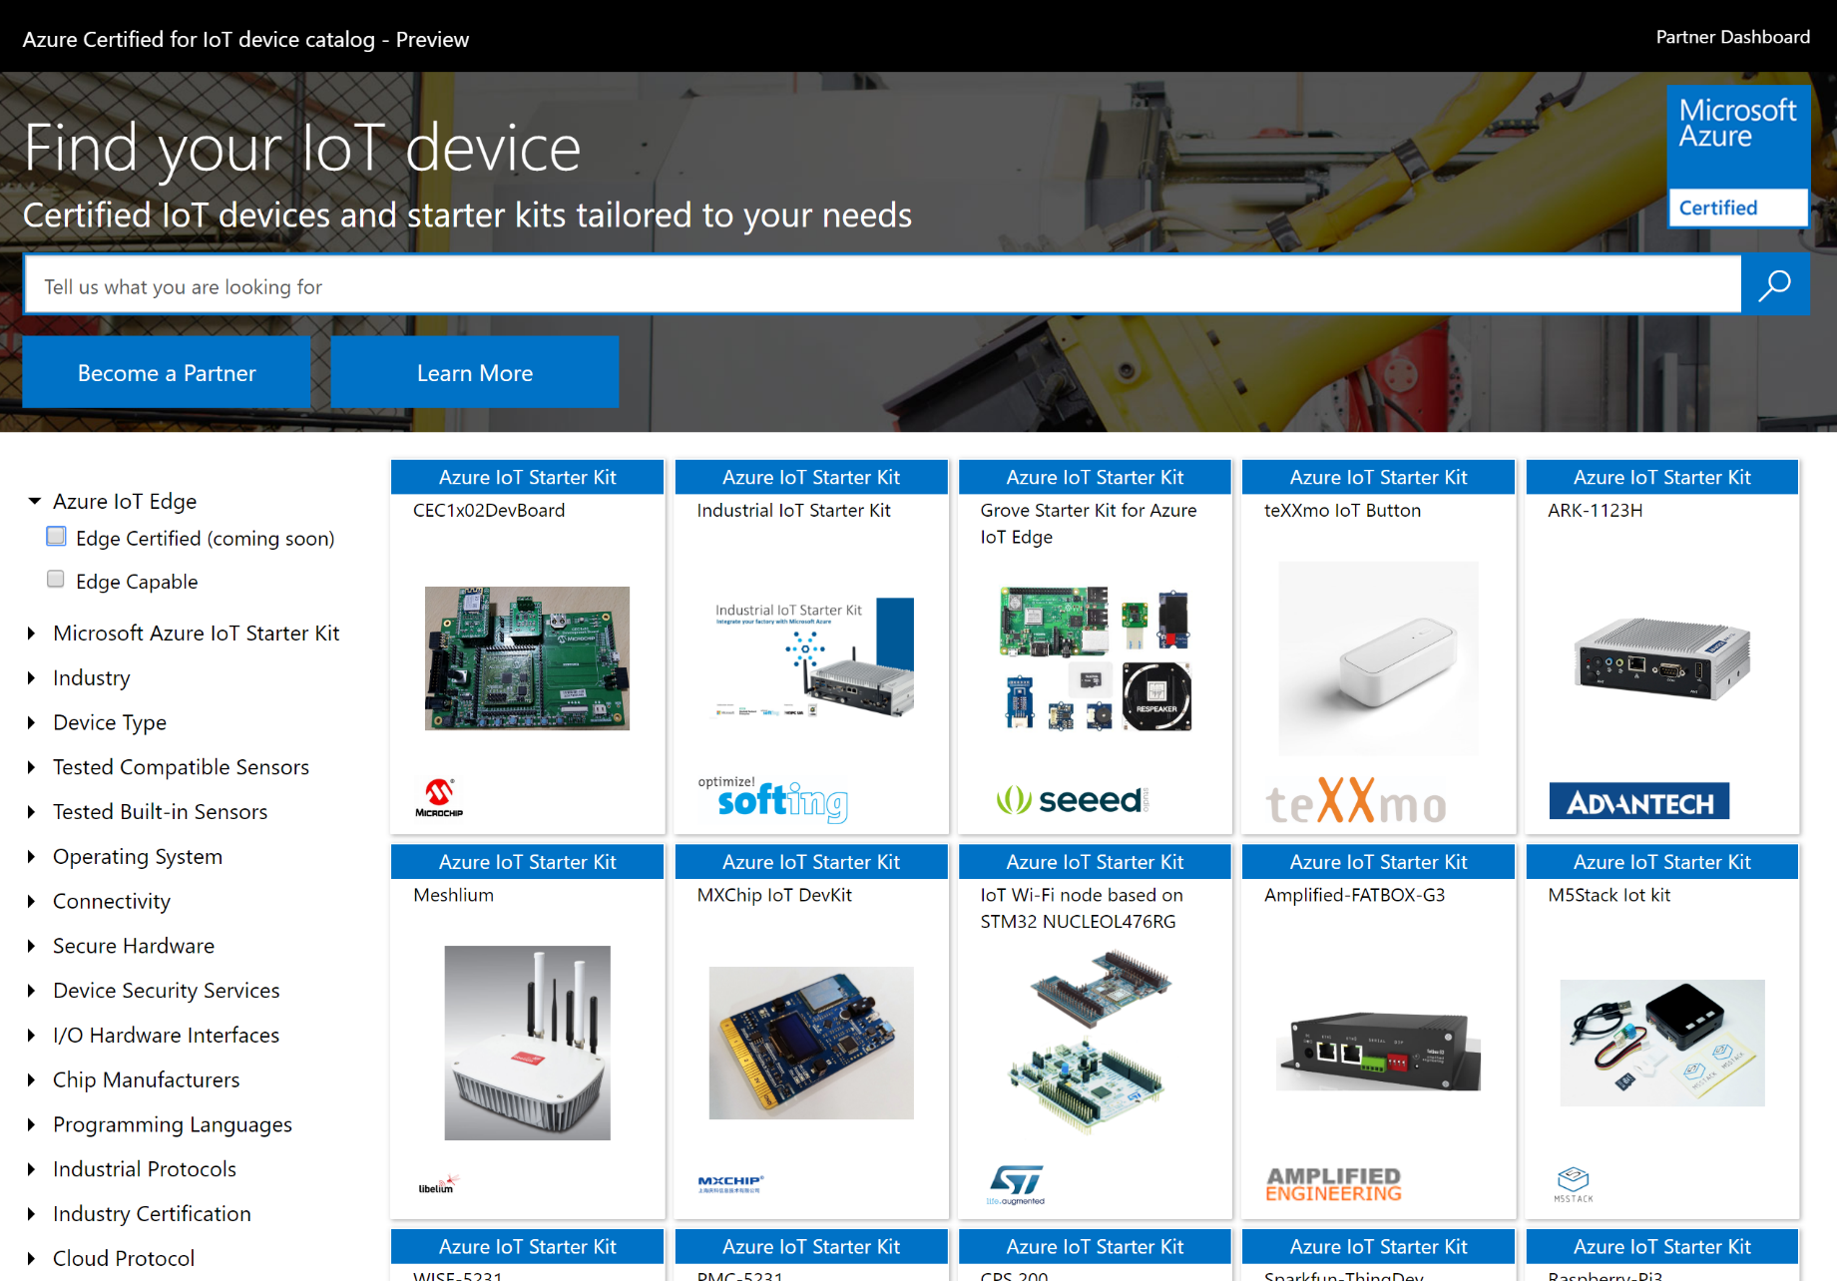
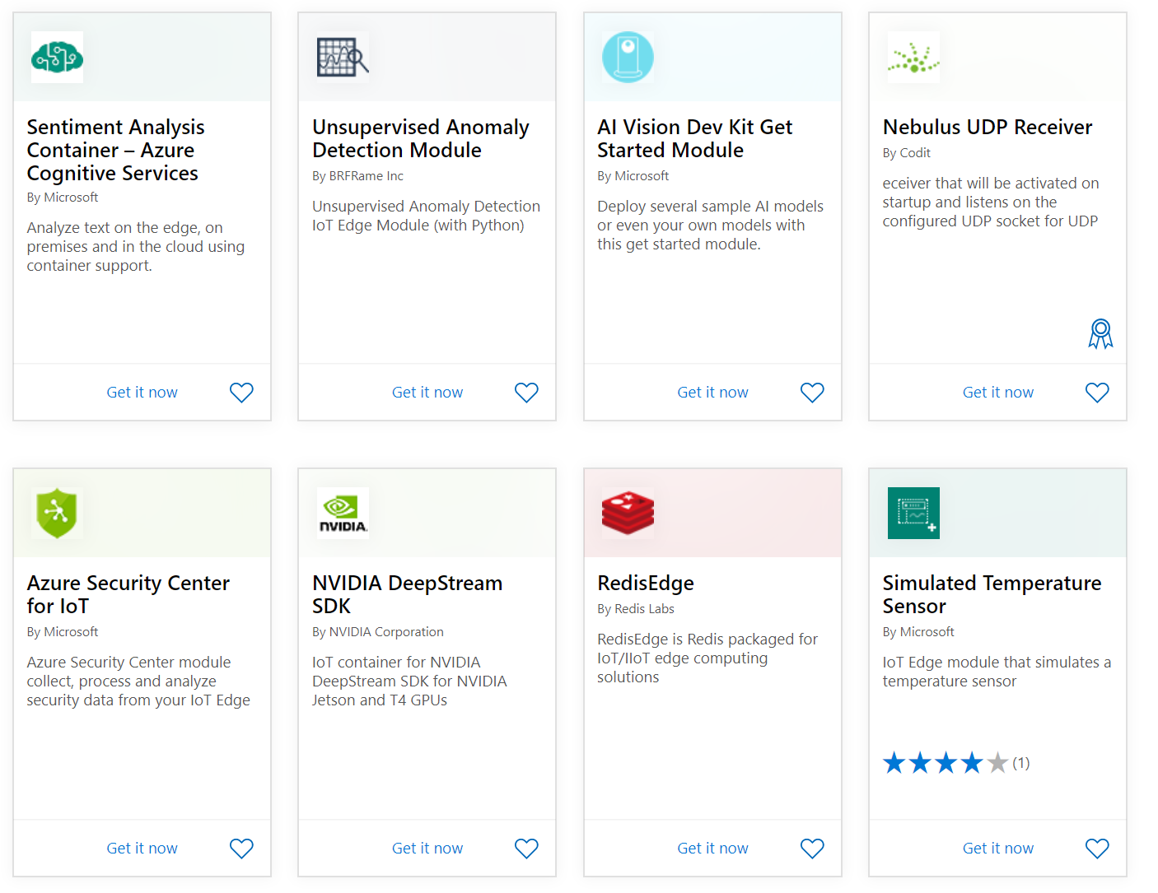
Two ecosystem programs
For ISVs: module marketplace
For ODMs: device catalog

Slide 21

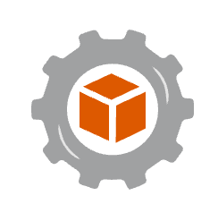
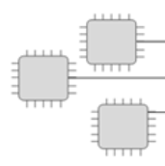
Azure IoT Central Edge Features
Manage IoT Edge devices, deploy edge software modules, publish insights, and take actions at-scale – all from within IoT Central
Azure IoT Edge Device Management
Azure IoT Edge device provisioning & connectivity
Symmetric Key
Module Management and Edge deployments
Group Enrollments
X.509 Certs
Module Telemetry ingestion and command & control
Symmetric Key
Per Module visualization & insights
Individual Enrollments
X.509 Certs
TPM
Module based rules & triggered actions
Device Relationships

Slide 22
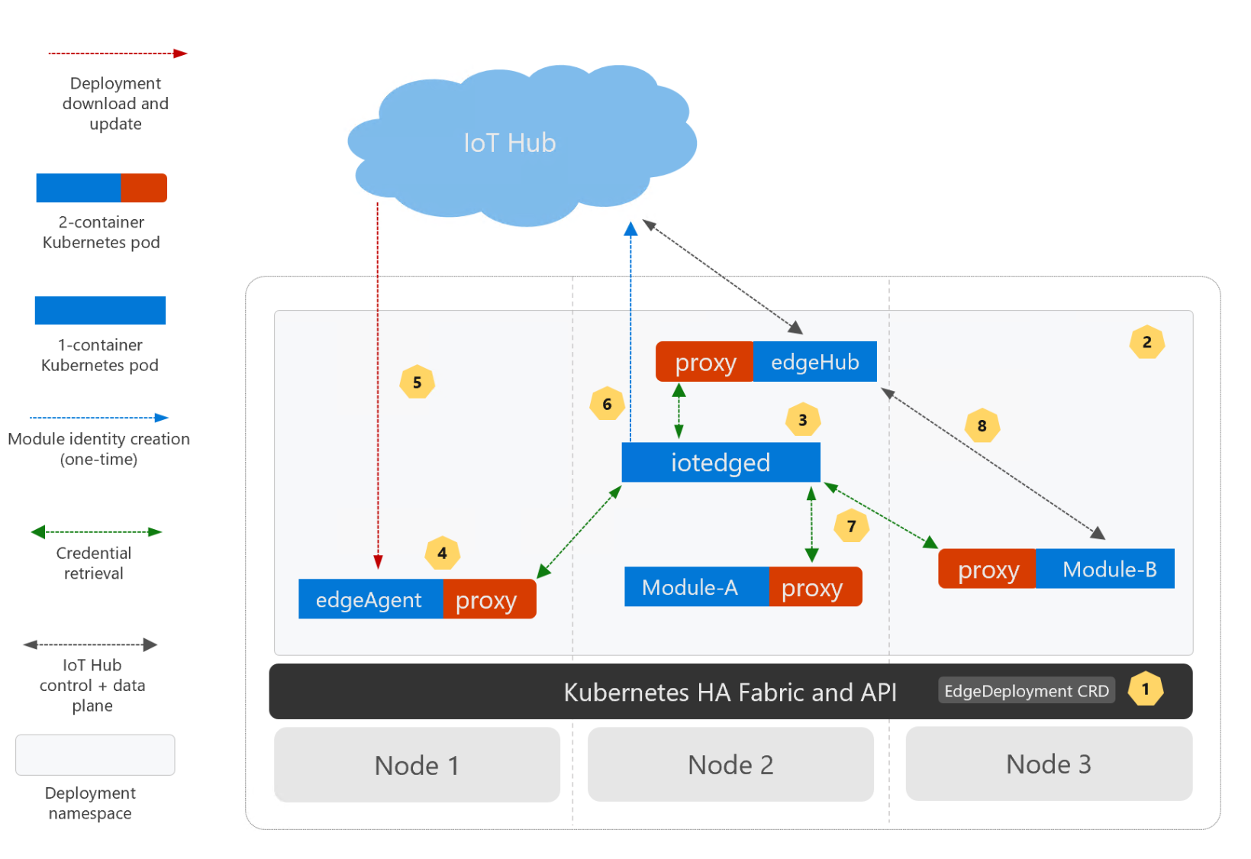
Public preview feature: Deploy IoT Edge workloads on Kubernetes
Adds hardware failure resilience to IoT Edge deployments by leveraging Kubernetes platform features
Manage applications from IoT Hub with the same familiar app model
Automatic translation to Kubernetes native application model (pods, services, deployments…)
Cluster can be shared by the multiple edge devices
Learn more: aka.ms/iotedge-on-kubernetes

Slide 23
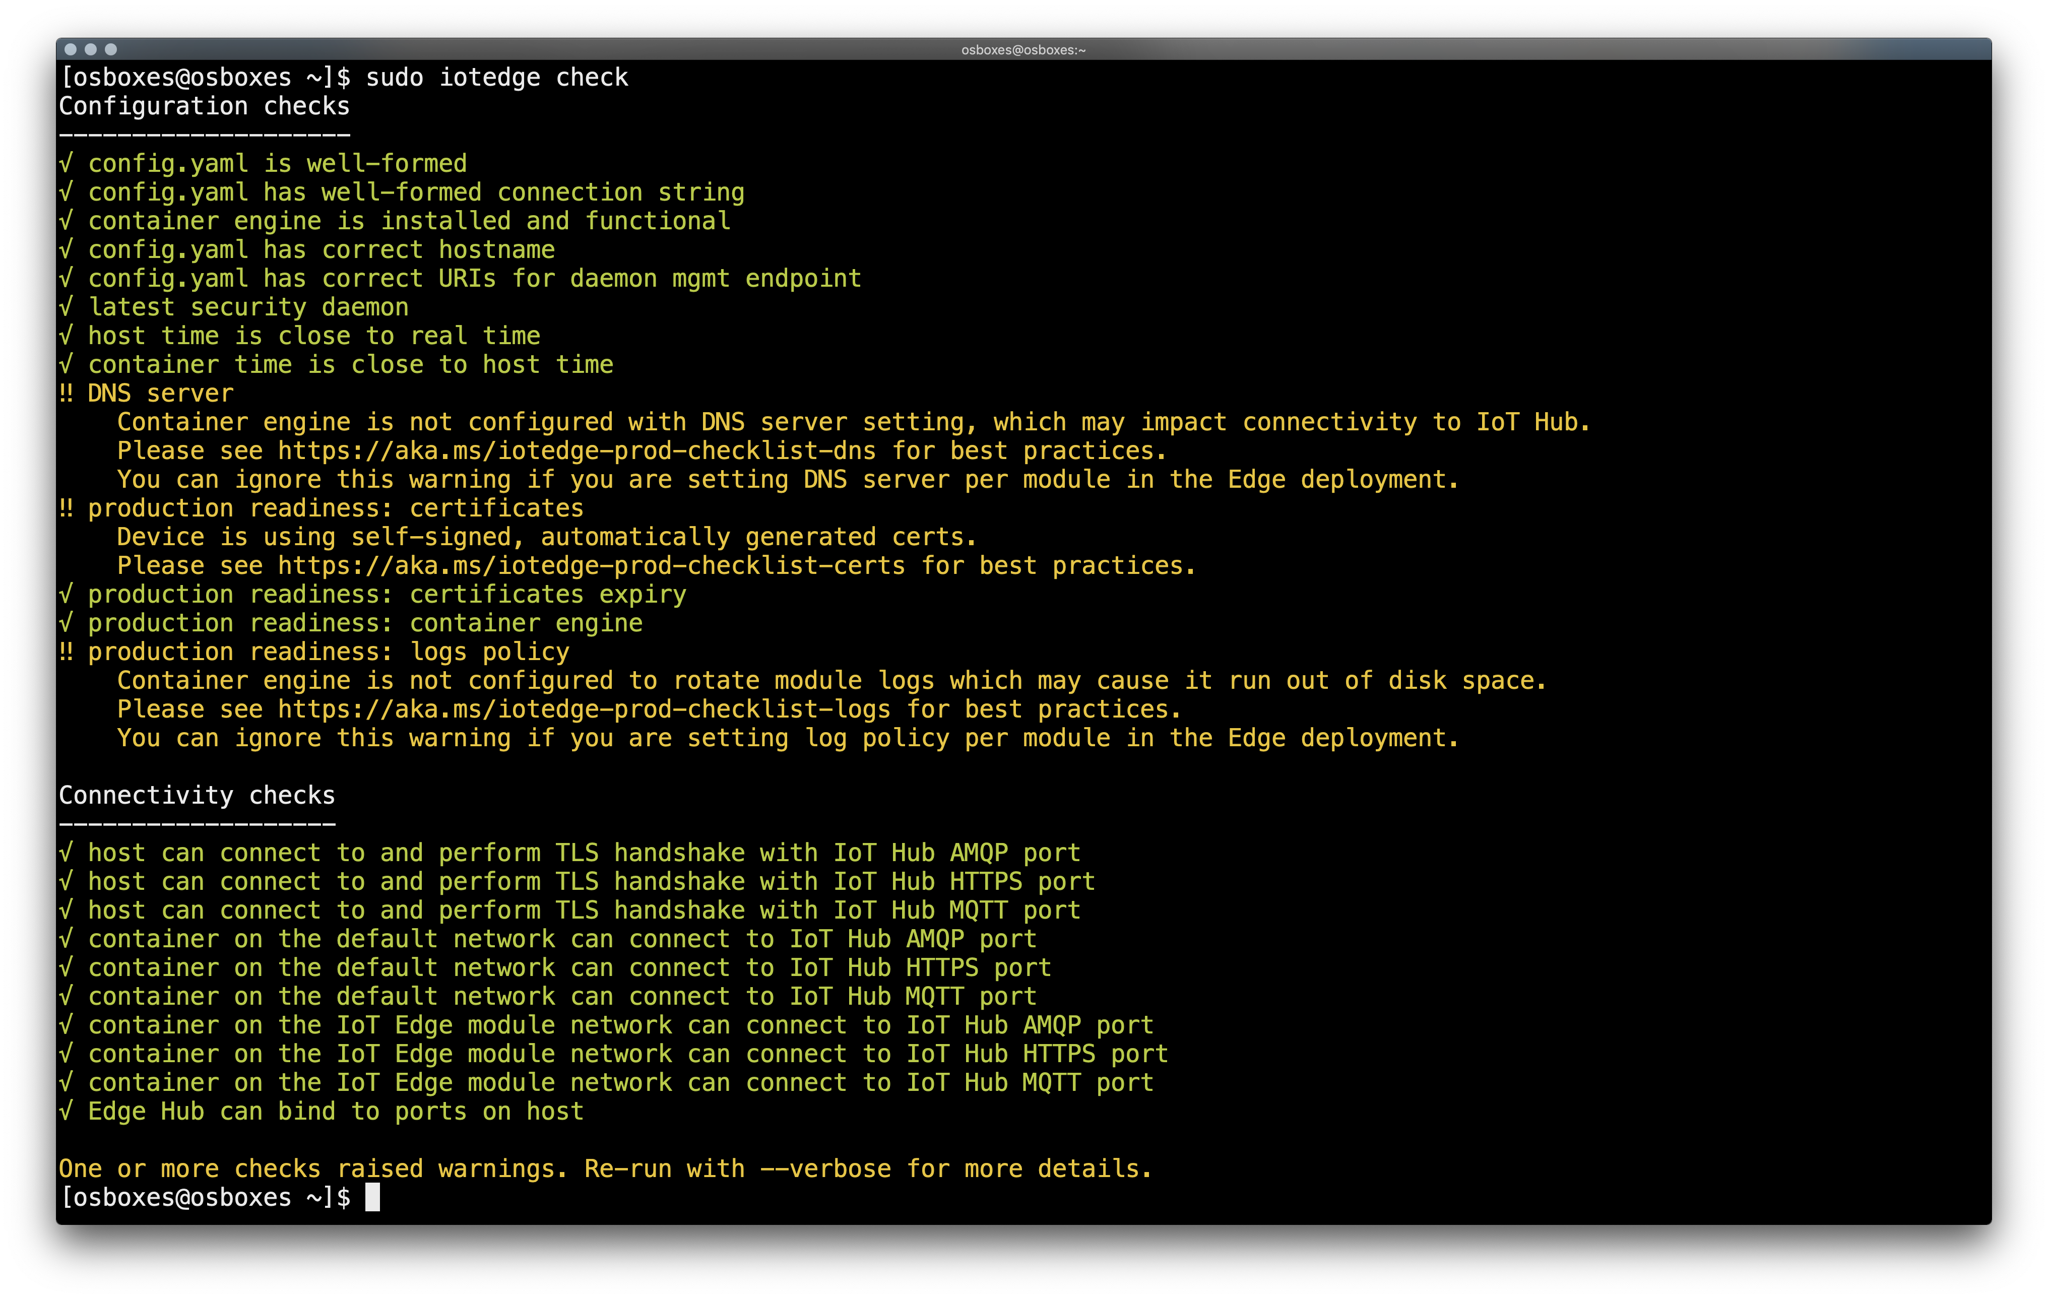
Built-in troubleshooting tool
Configuration checks
Production
readiness
Connectivity checks

Slide 24
Work with Azure IoT Edge
IoT Edge Overview & Features
AI on the Edge Overview
Tooling Support for IoT Edge
Lab:
Set up and deploy an IoT Edge Device
Developer Modules
Configure an IoT Edge device
Developer Resources & Getting started

Slide 25




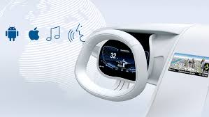
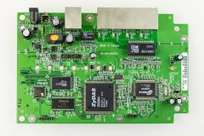
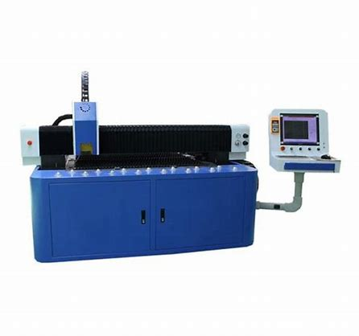

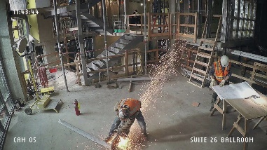


Time Series
Sound
Vision
Predictive maintenance
Speech
Camera as a Sensor
Asset configuration
Predictive maintenance
Workplace safety
Smart retail
Smart city
…

Slide 26

Time Series AI

Slide 27
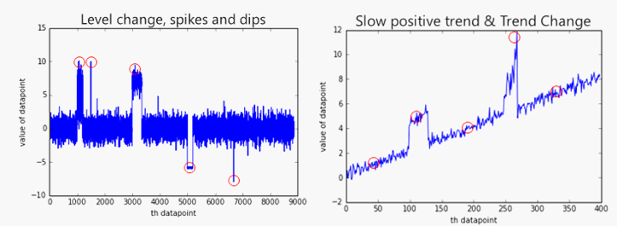
Use ASA / SQL DB Edge for out-of-the-box time series AI
Azure Stream Analytics
Unsupervised models for inline learning and real-time scoring
Easily invoked with simple function calls within query language
5 types of anomalies detected: Spikes and Dips, Slow positive/negative trend, Bi-level change
SQL Database Edge - Preview
Choice of platform (Linux, Windows on ARM64, x64)
Time-series built-in
AI built-in (Python, R, Spark, Java)
Turn-key management
Unparalleled performances and security

Slide 28

Vision AI

Slide 29

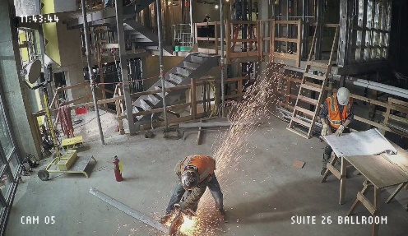

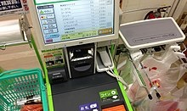
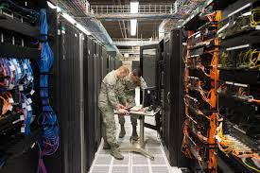

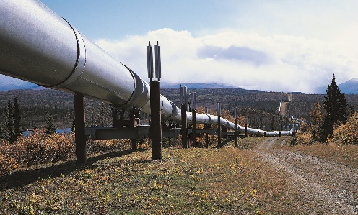
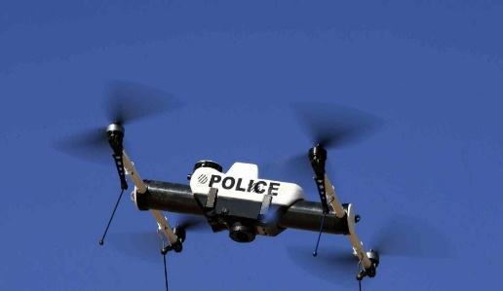
In IoT Computer Vision is about converting Cameras into Sensors
Retail
Industrial
Smart spaces
Shopper analytics
Workplace safety
Traffic
Loss prevention
Quality control
Access control
Shelf availability
Infrastructure inspection
Public safety

Slide 30


Worker Health and Safety for Construction and Manufacturing
Challenge
Difficult to enforce worker safety protocols leading to avoidable injuries and deaths
Solution
People detection and tracking combined with object detection identify unsafe conditions to enable better enforcement of safety protocols
Camera

Slide 31



Several pre-built AI containers from Cognitive Services
Custom Vision
Face detection
& Face recognition
Text recognition
Image Classification
+ Object Detection
http://aka.ms/visioncontainerspreview

Slide 32

Azure IoT Edge + NVIDIA DeepStream
EDGE APPLIANCE
Azure CLOUD
…
DeepStream container
Decode
Streamux
Inference
Tracker
Renderer
IoT Edge
Edge Agent
Edge Hub
IoT Hub
IoT Central
Docker
CUDA DRIVER
Edge Daemon
IoT DPS
NVIDIA GPU
HSM

Slide 33
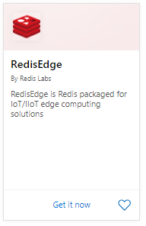
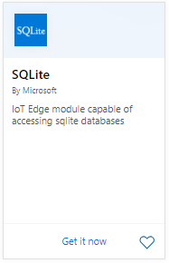
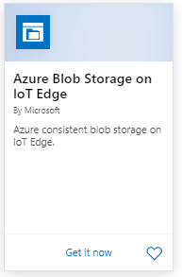
Managing your data
Telemetry (AI model output):
Store and forward upstream via the IoT Edge runtime
Store and query locally with a database from the Azure IoT Edge marketplace. For instance, Redis, SQLite or SQL server.
Large files (images, videos):
Use a local blob store (same REST API as the cloud)
Blob store has auto-tiering and auto-purging capabilities
Blob store includes store and forward for intermittent connections
Use a storage gateway like Databox Edge
It already syncs your data

Slide 34
Work with Azure IoT Edge
IoT Edge Overview & Features
AI on the Edge Overview
Tooling Support for IoT Edge
Lab:
Set up and deploy an IoT Edge Device
Developer Modules
Configure an IoT Edge device
Developer Resources & Getting started

Slide 35

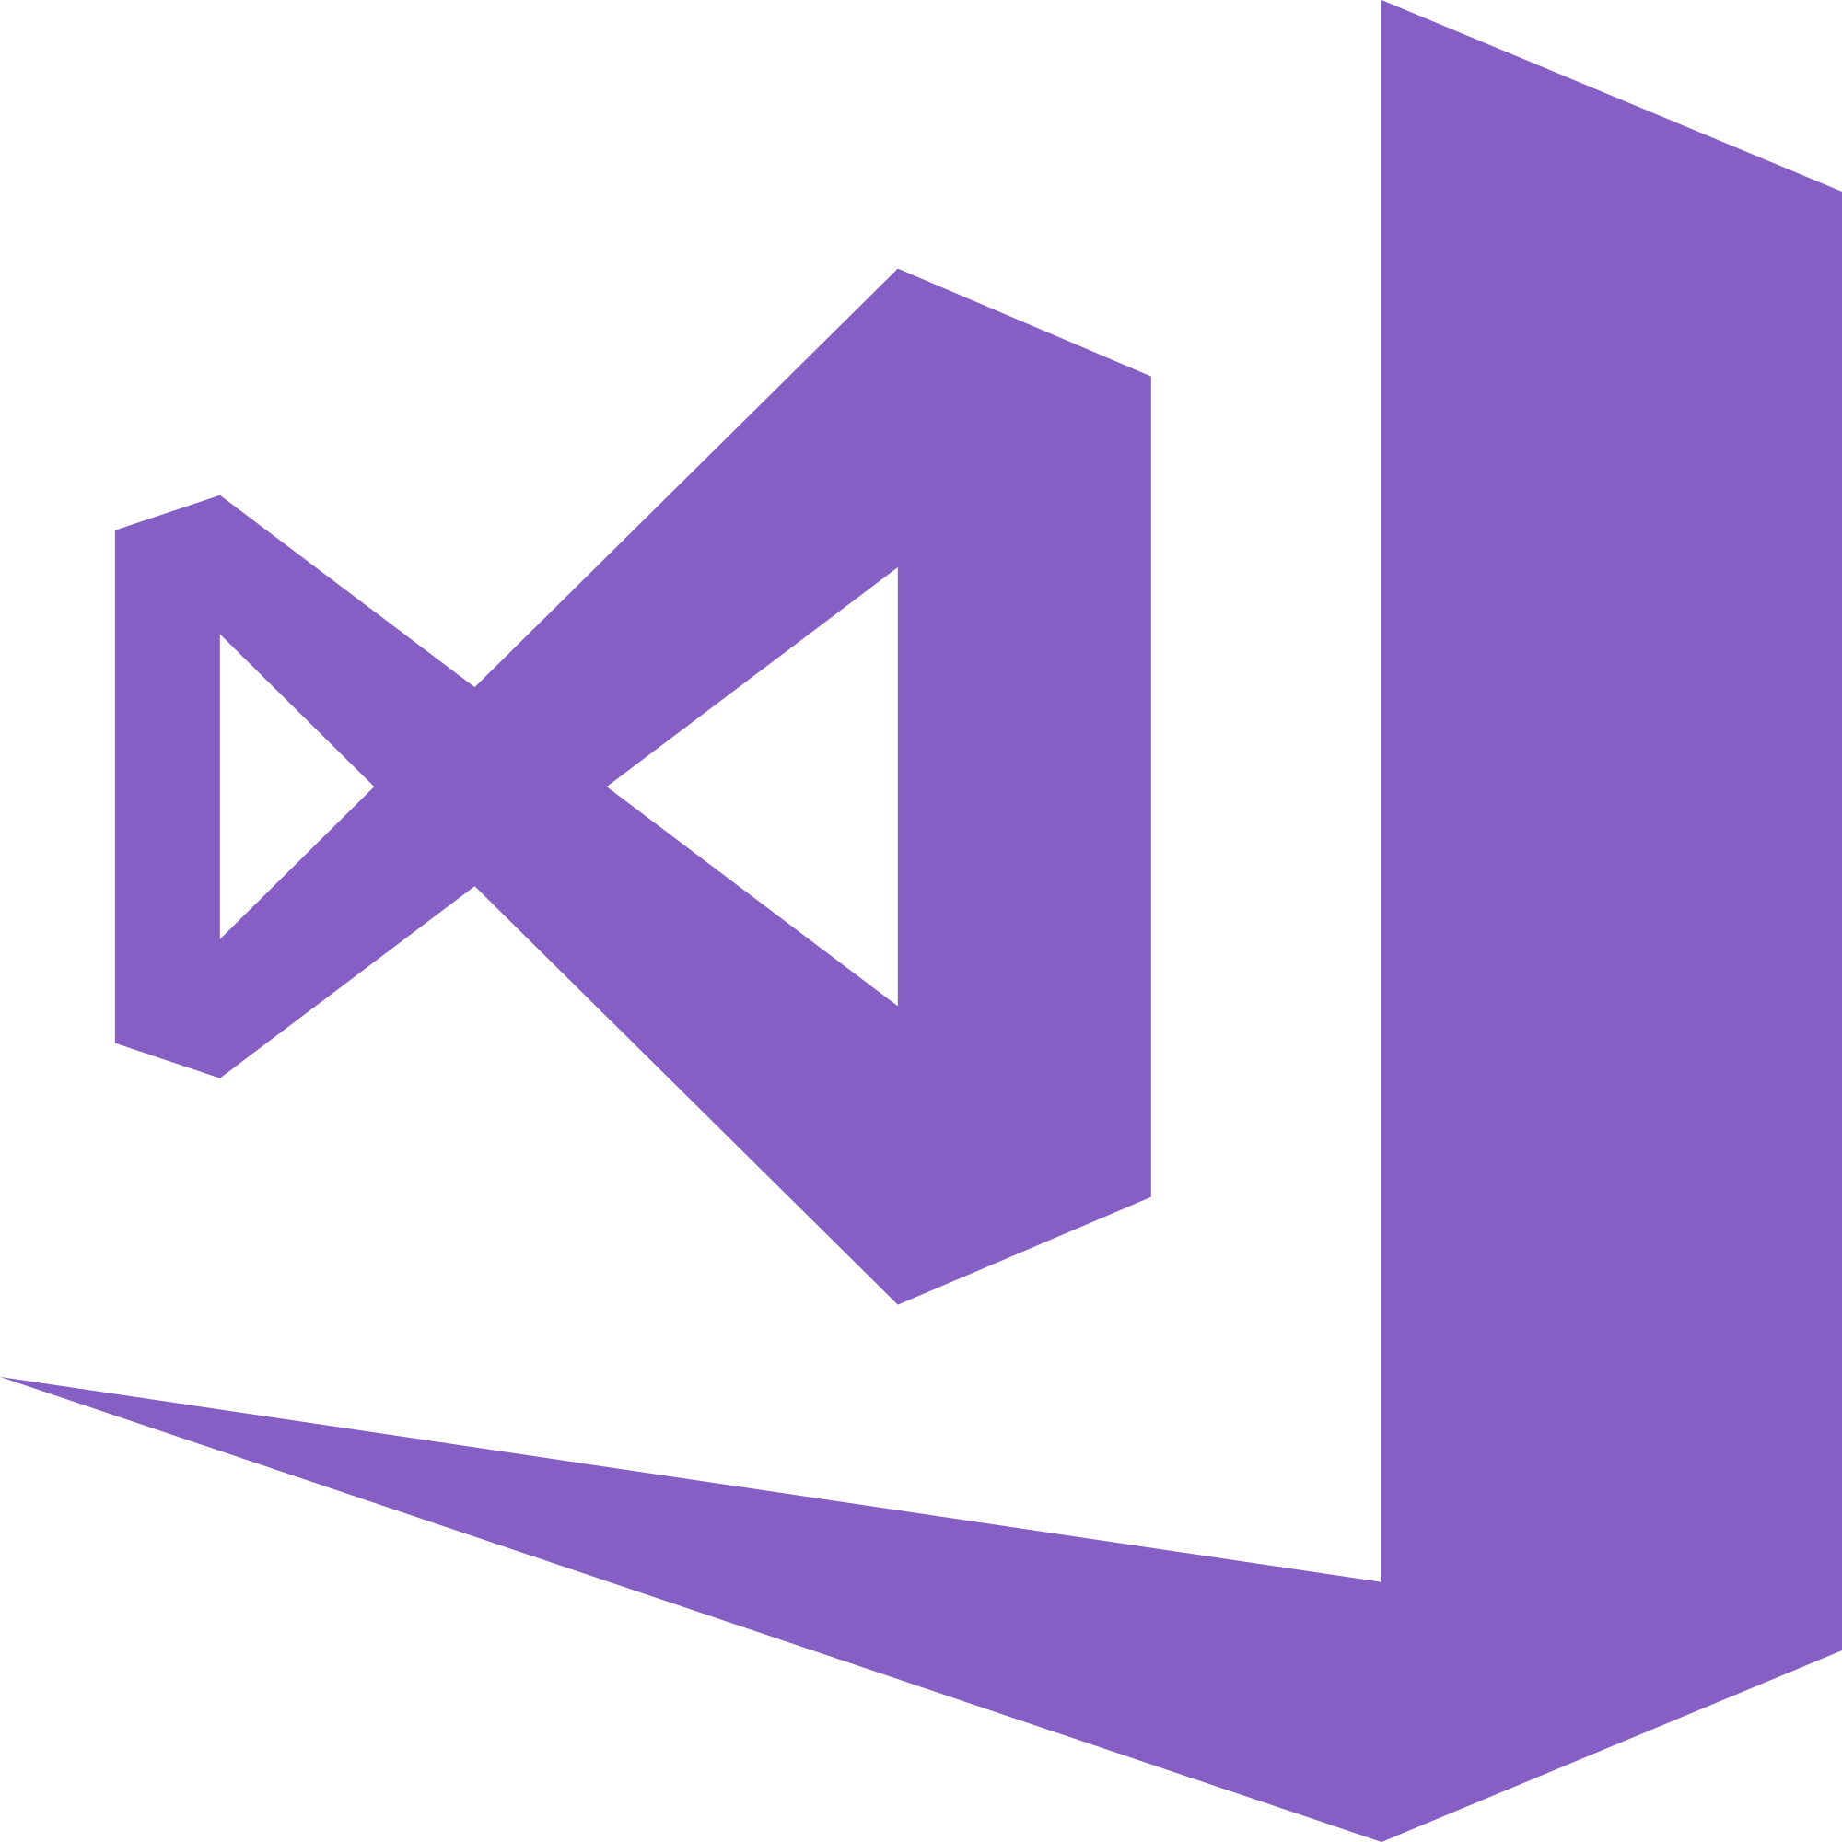

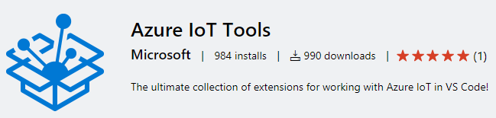
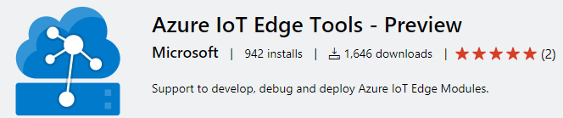
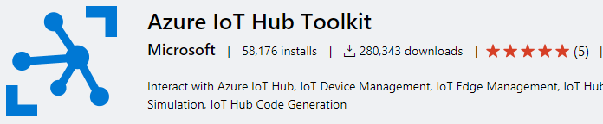

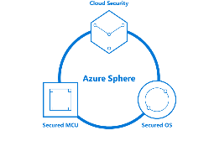
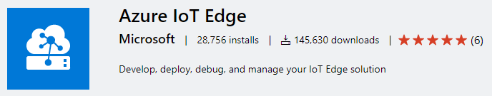

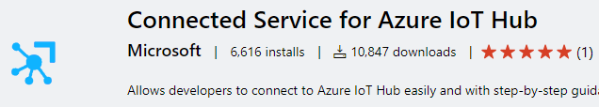
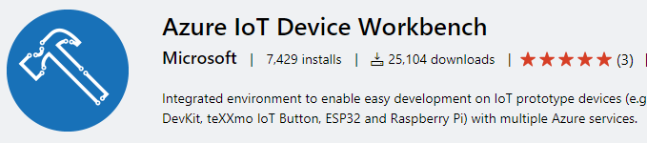

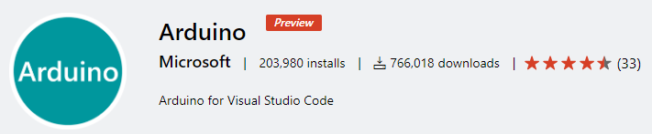
Azure IoT Tooling support
Visual Studio
Visual Studio Code
IoT DevOps
Azure IoT Hub support in Cloud Explorer
IoT Edge tasks for Azure Pipelines
IoT Edge Jenkins plugin
Azure DevOps project for IoT Edge
Azure Sphere Tools for VS
Azure IoT CLI Extension
iotedgedev CLI Tool
iotz

Slide 36
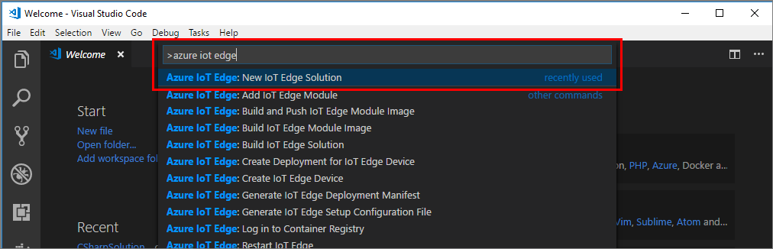
Develop Custom Modules with VS Code

Slide 37
Work with Azure IoT Edge
IoT Edge Overview & Features
AI on the Edge Overview
Tooling Support for IoT Edge
Lab:
Set up and deploy an IoT Edge Device
Developer Modules
Configure an IoT Edge device
Developer Resources & Getting started

Slide 38


Slide 39

Create Azure Services and solutions to be deployed on the Edge

Slide 40

Create containers and store them in a container registry like Azure Container Registry

Slide 41

Create a deployment manifest with Azure IoT Hub

Slide 42

Create a deployment manifest with Azure IoT Hub

Slide 43
Deploy Azure IoT Edge Enabled Linux VM
Linux VM
IoTHub
Edgeagent
Edge Runtime

Slide 44
Add an Edge Module and Deploy to Edge Device
Linux VM
Temp sensor
IoTHub
EdgeHub
FROM /messages/* INTO $upstream
Edgeagent
Edge Runtime

Slide 45
Deploy Azure Stream Analytics on Edge
Linux VM
Temp sensor
ASA-Edge
Control
temperature
Alert
IoTHub
EdgeHub
"telemetryToCloud": "FROM /messages/modules/tempsensor/* INTO $upstream", "alertsToCloud": "FROM /messages/modules/asajob/* INTO $upstream",
Edgeagent
Edge Runtime
"alertsToReset": "FROM /messages/modules/asajob/* INTO BrokeredEndpoint(\"/modules/tempsensor/inputs/control\")",
"telemetryToAsa": "FROM /messages/modules/tempsensor/* INTO BrokeredEndpoint(\"/modules/asajob/inputs/temperature\")"

Slide 46
Work with Azure IoT Edge
IoT Edge Overview & Features
AI on the Edge Overview
Tooling Support for IoT Edge
Lab:
Set up and deploy an IoT Edge Device
Developer Modules
Configure an IoT Edge device
Developer Resources & Getting started

Slide 47

Learn more aka.ms/azure-iot-edge
Get started docs.microsoft.com/azure/iot-edge

Slide 48

IoT Edge Workshops
Visual Anomaly Detection over multiple cameras with NVIDIA Jetson Nano devices
https://aka.ms/iotedge-iva-workshop
A collection of resources for connecting NVIDIA Jetson devices to Microsoft Azure
http://aka.ms/jetson-on-azure

Slide 49




Get Started Now!
Microsoft Learn learning paths
http://aka.ms/mslearniot
https://aka.ms/SecurelyConnectDevicesLearningPath
https://aka.ms/IntroAzureIoTLearningPath
Sign-up for Build end-to-end IoT solutions – Workshop Series
https://aka.ms/IoT-online-workshop
Transform your business with IoT
Devices and device communication – IoT Hub
Device provisioning at scale – Device Provisioning Service
Messaging processing, analytics, & business integration – Time Series Insights, Event Grid, Azure Stream Analytics
Work with Azure IoT Edge – IoT Edge

Slide 50




Learn how to get started with IoT
Building IoT solutions with Azure Developer Guide https://discover.microsoft.com/azure-iot-building-solutions-dev-guide/
Microsoft Learn learning paths
http://aka.ms/mslearniot
Microsoft Learn is a newer learning platform that offers sandbox online training
Azure IoT Reference Architecture Guide https://docs.microsoft.com/azure/architecture/reference-architectures/iot/
This reference architecture shows a recommended architecture for IoT applications on Azure using PaaS (platform-as-a-service) components.
Azure IoT Docs
Getting Started, Tutorials, How-to guides, reference, whitepapers

Slide 51




IoT Show
New video every Monday (Deep Dives on Wednesdays!) Subscribe to stay up-to-date with latest Microsoft IoT announcements, product and features demos, customer and partner spotlights, top industry talks, and technical deep dives with IoT Show! aka.ms/IoTShow
https://aka.ms/iotshow/deepdive

Slide 52

IoT Tech Community
Community forum to stay to update on latest announcements, connect with other developers, share your projects, and ask questions!
Fast growing vibrant community
One Microsoft IoT voice
http://aka.ms/iottechcommunity

Slide 53






Nvidia IoT Edge device spectrum
Sensors
Constrained
Industrial
Server
Stack
Azure IoT Edge
Nano
TX2
Xavier
T4
JETSON (arm64)
TESLA (amd64)
# streams
(1080p 30fps h265 resnet10)
8
14
49
68
Notes:
Microsoft provides the most complete edge computing portfolio. With the acquisition of express logic, we have offerings from RTOS’s and Azure Sphere, which is a secure by default MCU, to Azure Stack which is an on premises private cloud.
Azure IoT Edge runs across a broad variety of these devices. Today we can run on a device as small as an RPi3 and in the future we’ll get even smaller. On the high end, IoT Edge can be run on server class hardware like Data Box Edge. Choosing the right hardware depends on the workload.
IoT Edge supports both ARM and Intel architectures.
IoT Edge runs on Linux and Windows, pretty much any OS that supports containers.
As of Monday, we are GA on Windows IoT Enterprise!

